Slide 1
Building Inhibitors of Lung Cancer using De Novo Drug Design
By: Jared Atienza and Dr. Anderson

Slide 2
Why Lung Cancer?
Responsible for 25% of all cancer deaths- (highest among all cancers)
1 in 15 males and 1 in 17 females will develop lung cancer in his or her life
Second most common cancer in both men and women
American cancer society 2021

Slide 3
Lung Cancer and COVID-19
Cancer patients are more susceptible to COVID-19
Healthcare system exposure
Immunosuppression
Journal for ImmunoTherapy of Cancer 2021

Slide 4
PD-L1 Protein target
PD-1 antibodies on T-cells bind to PD-L1 antibodies on cancer/healthy cells
OPDIVO drug binds to PD-1 to activate T-cells
Active T-cells will attack cancer cells and healthy cells
OPDIVO (nivolumab) 2021

Slide 5
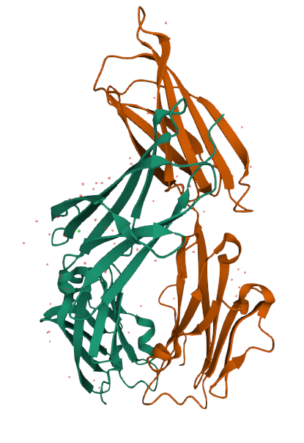
PD-L1 Protein

Slide 6
Research Objective
The objective of this research project was to use De Novo Ligand design program to predict which compounds would have high binding affinity to target PD-L1 protein limiting lung cancer growth.

Slide 7
Methods
Run De Novo Ligand design 11 times to find 11 different ligands through ~50 generations
Calculate the binding affinity of the 11 compounds
Insert files of the ligands into ADMET web server to predict human intestinal absorptivity and toxicity
Acquire SMILES string from ADMET web server
Identify and remove ligands that are toxic and cannot be absorbed by the GI tract
Create 2D structure for remaining ligands
Select ligands with high binding affinity, high human intestinal absorptivity, and non-carcinogenic
Create 3D images of ligand bound to PD-L1 protein
Notes:
Smiles string - single line of text that encodes for the 2d structure of the ligands

Slide 8
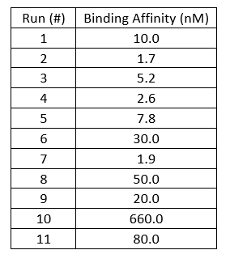
Results
Table 1: Binding affinities (Kd) for all 11 ligands
* Binding affinity (Kd) <500 nM is considered very good

Slide 9
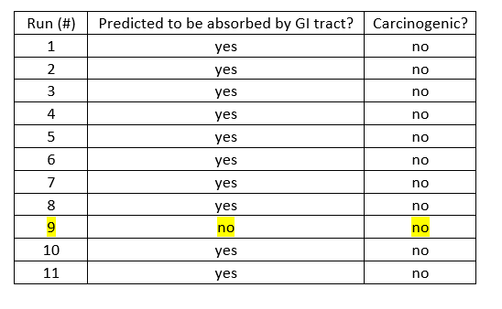
Results
Table 2: GI absorption and toxicity for all 11 ligands

Slide 10
Results Explained
Based on the results of the ADMET web server, all ligands, with the exception of ligand #9, possess the desirable qualities of both high gastrointestinal absorptivity and predicted to be non-carcinogenic.

Slide 11
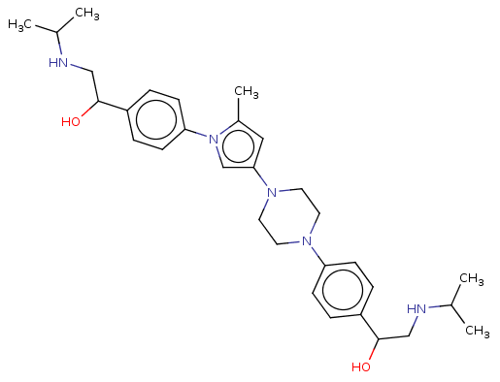
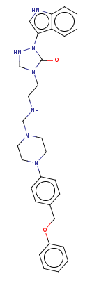
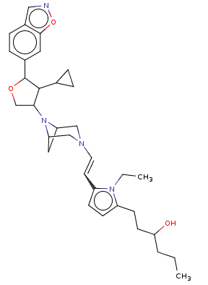
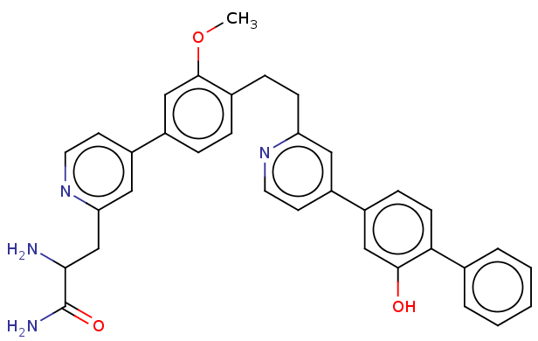
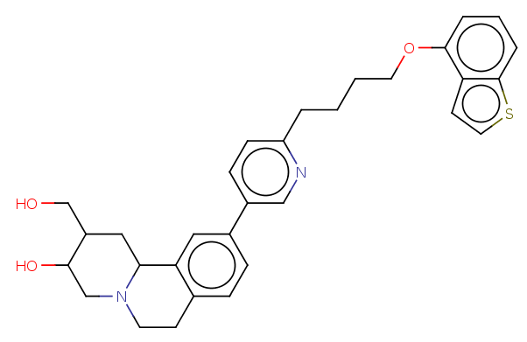
Structures of Ligands
Ligand 3 (5.2 nM)
Ligand 2 (1.7 nM)
Ligand 1 (10.0 nM)
Ligand 5 (7.8 nM)
Ligand 4 (5.2 nM)

Slide 12
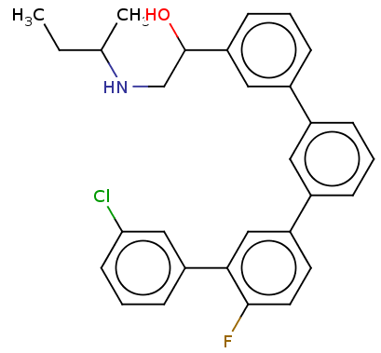
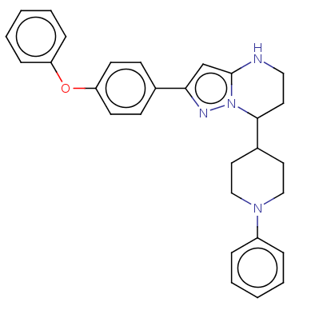
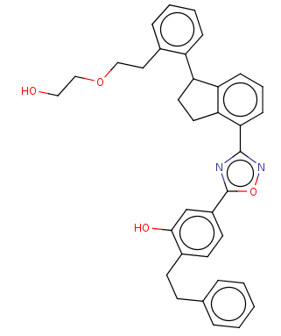
Structures of Ligands
Ligand 6 (30.0 nM)
Ligand 7 (1.9 nM)
Ligand 8 (50.0 nM)

Slide 13
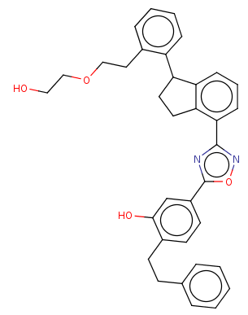
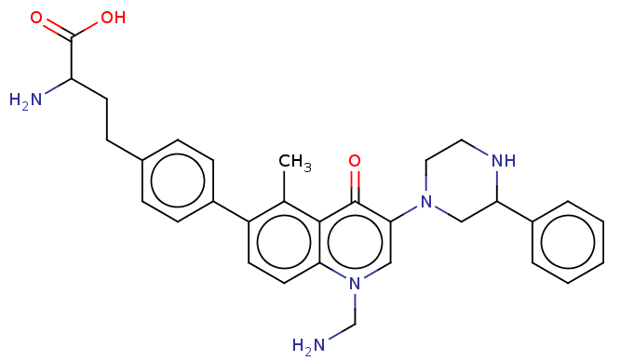
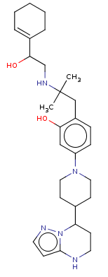
Structures of Ligands
Ligand 10 (660.0 nM)
Ligand 9 (20.0 nM)
Ligand 11 (80.0 nM)

Slide 14
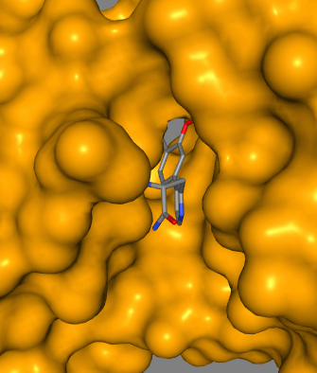
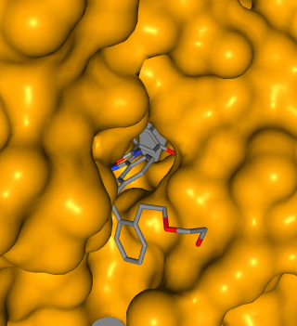
3D structures of desirable ligands
Ligand 2
Ligand 7

Slide 15
Conclusion
From the data received by the ligand data programs, I can conclude that ligands 1, 2, 3, 4, 5, 6, 7, 8, & 11 could bind with high binding affinity (Kd < 500 nM) to the PD-L1 protein and thereby hinder lung cancer spread.
Out of all the ligands that possessed desirable qualities, ligand 2 had the best binding affinity (Kd = 1.7 nM).
Ligand 2 (1.7 nM)

Slide 16
References
How combination therapy works. (n.d.). Retrieved June 6, 2021, from Opdivo.com website: https://www.opdivo.com/about-opdivo/how-the-combination-works-combinationtherapy
Passaro, A., Bestvina, C., Velez Velez, M., Garassino, M. C., Garon, E., & Peters, S. (2021). Severity of COVID-19 in patients with lung cancer: evidence and challenges. Journal for Immunotherapy of Cancer, 9(3), e002266.
Torre, L. A., Siegel, R. L., & Jemal, A. (2016). Lung cancer statistics. Advances in Experimental Medicine and Biology, 893, 1–19.

